Slide 1
Stack-Buffer Overflow on 64-bit binary
Keshaw Kumar Burnwal
Notes:
Wonderful morning everyone. Today, I will take a webinar session on stack-buffer overflow exploit and how it can be used to pawn a machine. First, I will give a short overview on various concepts related to buffer-overflow attacks. Then, I will illustrate how you can search a binary for buffer-overflow vulnerability and exploit it. In case you have any doubts OR you think I said something wrong feel free to interrupt me.

Slide 2

About Myself
Master of Eng., Cyber Security, University of Maryland College Park
Certified Ethical Hacker (CEHv9)
3.5 years in software development
McAfee
Symantec
Notes:
I am a graduate student at University of Maryland, College Park. I am from India. Here I worked in software development for 3.5+ years. I always loved ethical-hacking. Also, India has acute shortage of cyber-sec experts. So, I am here.
I am into pen-testing for almost a year.

Slide 3
Prerequisite
Perseverance
Basic knowledge of programming language, preferably Python or Perl
Basic understanding of memory layout for a process
Basic knowledge of assembly instructions
Familiarity with debugging tools
Linux: edb, gdb
Windows: ollyDbg.
Notes:
As you all may know, to execute a buffer overflow is a bit-tedious task. You need to understand lots of nitty-gritty. A slight overlook can result in failure. So you need perseverance in tons. Then you need knowledge of any programming language. I personally prefer Python as I find it easier to create a payload. You must have basic familiarity of memory layout of process- .bss, .text, stack, etc. Further, you should be able to understand assembly instructions to make a fair guess about a binary. Last but not least, you must have fair knowledge of debugging tools like gdb, edb, etc.

Slide 4
Assembly Instructions
Important registers
RSP : stores content on top of a stack
RIP: stores address for next instruction
RDI, RSI and RDX: stores first three arguments passed to a method
Important instructions
MOV <dest>, <src>
Copy value from source to destination
Call <address>
Change RIP to specified address
Ret
Pop to RIP
Notes:
Just to recap about assembly language, there are many registers. However, ones of importance are RSP and RIP. RSP points to top of stack, while RIP tells about next instruction to be executed. Similarly, RDI, RSI and RDX stores first three arguments passed to any method.
Assembly language have tons of instructions. However, we are mostly concerned with MOV, CALL and Ret. Mov… , call… and ret… <use slide>

Slide 5
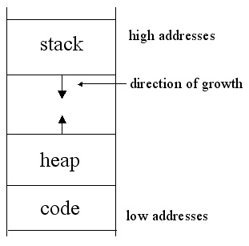
Stack (Last in First Out)
PUSH
Moves data onto stack
Removes 8 bytes from RSP
POP
Removes data from top of stack
Adds 8 bytes to RSP
Notes:
Just to recap, stack grows from high memory address to low memory address. Hence PUSH means, adding a value on bottom of stack and removing 8 bytes from RSP. Similarly, POP removes value from bottom of stack and subtracts 8 bytes from RSP.

Slide 6
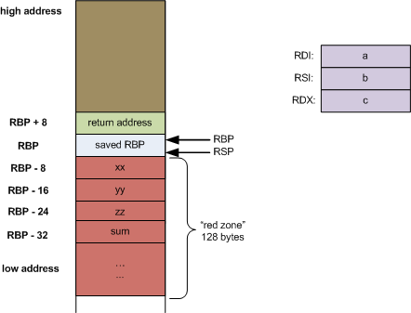
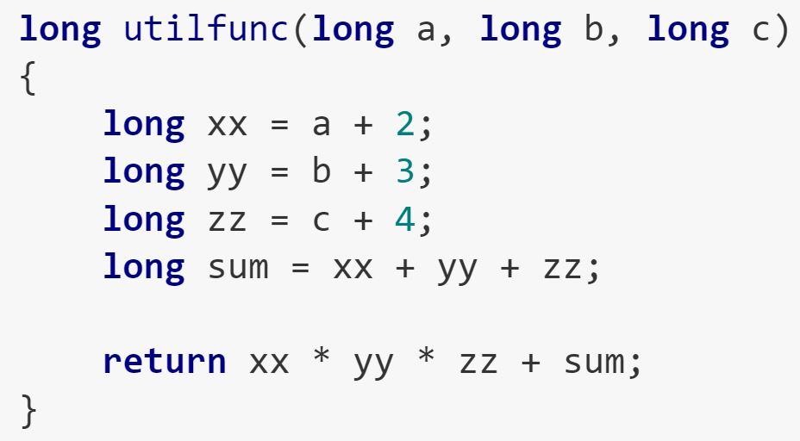
Stack-frame layout
Notes:
This image shows a stack-frame layout for a simple program. As you can see, three arguments are stored in RDI, RSI and RDX. Further, you can notice that above “saved-RBP”, there is return address. Once a program is complete, this return address is passed to RIP. Also, local variables are stored at RBP-8, RBP-16, etc.

Slide 7
Stack-based Buffer overflow
A buffer overflow is an anomaly where a program, while writing data to a buffer, overruns the buffer's boundary and overwrites adjacent memory
Buffer overflows can be triggered by inputs that are designed to execute code, or alter the way the program operates
By overwriting the return address in a stack frame. Once the function returns, execution will resume at the return address as specified by the attacker, usually a user input filled buffer.
Notes:
Buffer-overflow is an anomaly in program. As a result, data is written beyond designated area. Hence, we can change ‘return address’ of a method. Thus controlling flow of a program.

Slide 8
DEMONSTRATION.
Using a 64-bit Linux based executable
source code not available
No stack smashing protection
ASLR disabled
Stack is executable.
No stack canary
Notes:
With all basic theory being covered, let’s move to demonstration. Here I will show how to exploit a buffer-overflow vulnerability to take control of a machine. Just for simplicity, I am assuming that Address Space Layout Randomization (ASLR ) is disabled. This means, address of a instruction will not change each time a binary is restarted. Similarly, there is no anti-stack smashing measures like stack canary. Also, our stack is executable. This means any instruction that will be placed on stack can be executed with any error.
For this demo, I will use a 64 bit Linux-based binary.

Slide 9
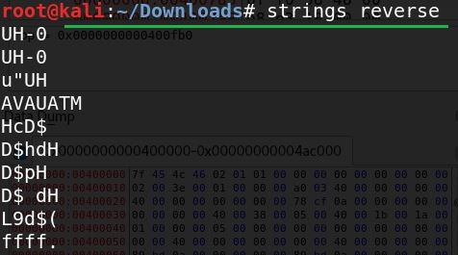
Basic Enumeration
file <file_name> // to know about binary and operating system it supports
checksec.sh <filename> // to know about security
Strings <filename> // to know what strings are present inside binary
Notes:
When you receive a binary, first thing to do is execute file command to know about file format. Next run checksec.sh to find about security precautions placed on an executable. At times, strings command gives interesting information.

Slide 10

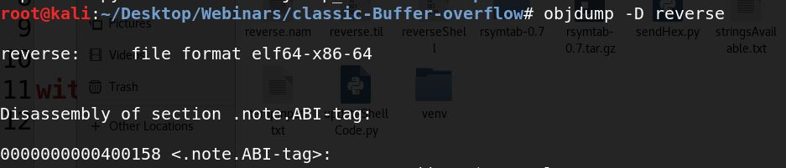
Basic Enumeration(Cont.)
network connection created by binary
Dynamically linked libraries
Objdump <filename>
No extra information since binary is statically
linked
Notes:
Next we find out if binary is creating any network connection. To find all dlls loaded by binary use ldd command. Objdump also gives plethora of information.

Slide 11
Static and dynamic debugging
Using IDA Pro Community edition
Graph view aids in understanding binary
Auto-names known functions and libraries.
Not useful for statically linked binaries.
Use debugger for dynamic analysis
EDB or GDB.
Breakpoints to understand flow
Inspect values of registers and even modify them
Inspect values stored in stack.
Notes:
<Use Slides content>

Slide 12
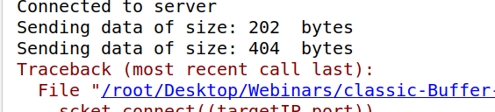
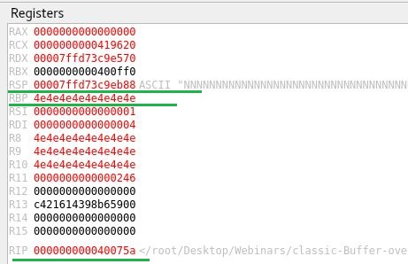
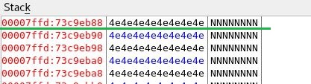
Dynamic Debugging
Check if user-input can control RIP
Pass large input to crash program
Analyze registers for value
Notes:
Our next step is to check, if we can control RIP. So we pass a very large input and inspect register values. We see that RBP is user controlled .

Slide 13
Stack content are user controlled but indirectly.
Understand binary behavior by passing different inputs.
Binary does ROT-13 encryption
Last statement to be executed to ‘ret’
POP RIP
Notes:
We see that RSP points to some value that is user-controlled. But there is some manipulation happening. So next step is to understand binary behavior. We pass various inputs to the binary for this purpose. We see that binary is doing ROT13 encryption.

Slide 14
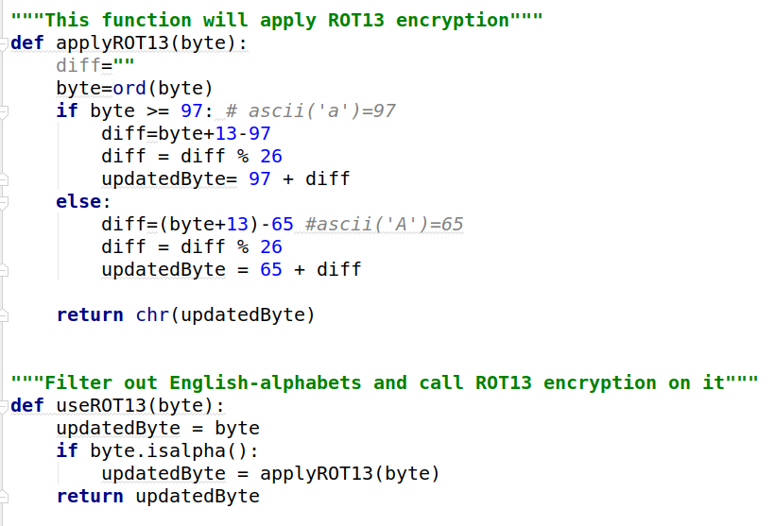
Encryption
ROT-13(ROT-13(PT)) = PT
Write ROT-13 encryption module.
Notes:
A bit of google tells me that double ROT-13 encryption gives me original text. So I write a ROT-13 encryption module. Then pass user-input again.

Slide 15
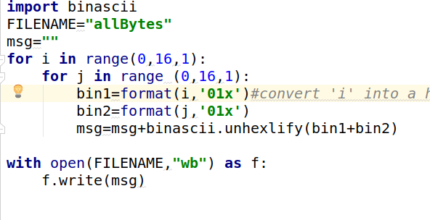
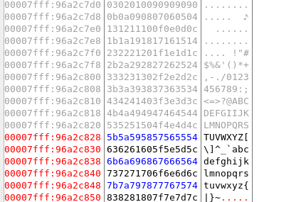
Find bad characters
Send all possible hexadecimal bytes as input
Look into stack for any missing byte.
Notes:
Now that, we can control RSP and RIP we know that this binary has buffer-overflow vulnerability. Also, we can exploit this vulnerability. Next step will be to find out if this binary treats has any bad characters. At times bytes like \x0a (line feed), \x0d (carriage return) are treated differently. So we need to exclude such characters from our input.
So I create a payload with all possible bytes and pass it to our binary. Now, we need to compare value in stack with user-input. We see that all bytes are present in stack. So, there are no bad characters.

Slide 16
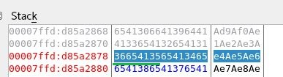
Find input-position for registers, RBP, RSP, RIP
Use offset_create.rb to create unique string
Analyze register and stack values.
Use offset_pattern.rb to get position for various registers
Confirm this offset.
Notes:
Now, we need to find exact position of bytes that corresponds to RBP and RSP. For this, I create a pattern of unique strings. I pass this pattern to the binary. Then I analyze values stored in these registers for our offset.
Just to double check, I modify my input to include deadbeef. I aim that registers should have “deadbeef”.

Slide 17
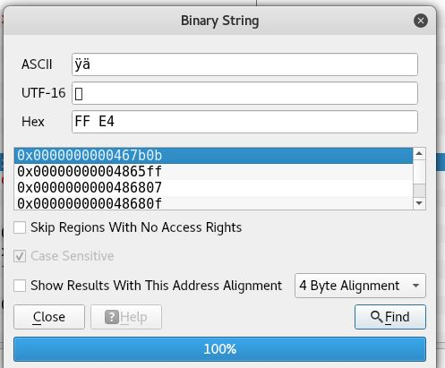
“Tell” RBP ‘jmp RSP’
‘ff e4’ opcode for jmp rsp
After ret, top of stack will be copied to RIP
ShellCode is executed
No ASLR. So address of “ff e4” won’t change.
0x467b0b
ShellCode max size = 260 (404-136-8)
Notes:
So I know position of RBP, and RSP. I know that RSP can have my malicious code. This malicious code can have max length of 260 bytes. All I need to do is tell binary to start executing my code.
You may remember that once ret is executed, RBP is copied to RIP and RIP tells about next instruction to be executed. So some-how if I can put ‘jmp RSP’ at RBP my shellcode will be executed. So I google for opcode for ‘jmp RSP instruction’ and find location of such instruction within my binary. Remember, ASLR is off for this binary. Hence, address of opcode won’t change even after binary is restarted.

Slide 18
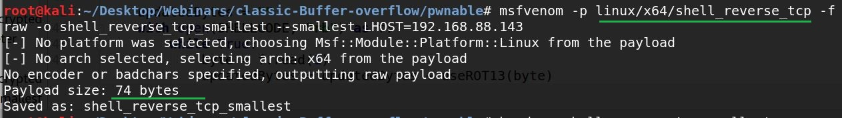
Final Payload
ShellCode of 74 bytes.
Fill extra space with NOPS , no-operation sledge.
‘\x90’
CPU ignores it and moves to next byte
Notes:
I know that Shellcode can be max of 260 bytes. Let’s use msfvenom to create a smallest possible payload. We get shellcode of 74 bytes.

Slide 19
Final Payload
ShellCode of 74 bytes.
RSP points to 137th position
Final Payload
<132 bytes of NOPS><8 bytes of jmp RSP><20 bytes of NOPS><74 bytes of shellcode> <NOPS for padding>
Notes:
I use all information thus gathered into a payload of size 404 bytes and pass it to the binary. Our final payload should be ….”use slide”. Now, let me execute it.

Slide 20
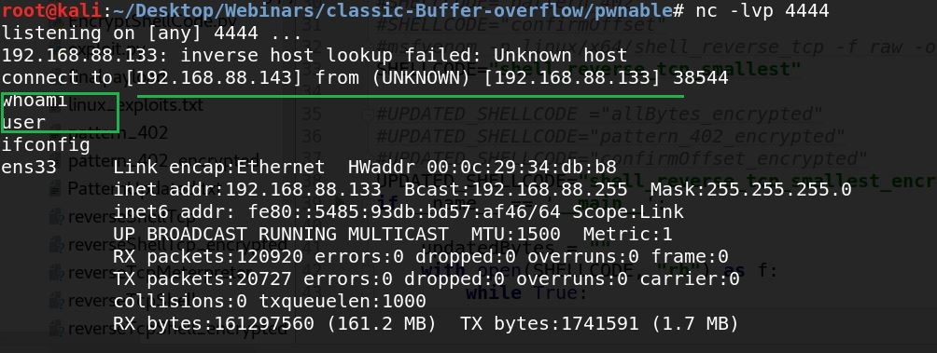
Exploited
Start a listener
Port 4444
Got a shell
Notes:
Now I start a listener at port 4444. send my payload. As you can see I got a shell.

Slide 21
Tools Used
CheckSec.sh https://github.com/slimm609/checksec.sh
Edb-debugger https://github.com/eteran/edb-debugger
GDB-Init https://github.com/gdbinit/Gdbinit
Notes:
These are tools that I used.

Slide 22
Acknowledgment:
Binary is not mine. It is part of an open-challenge.
Tyrone Wilson, Cyber6 Solutions
Notes:
Binary that I used for this purpose doesn’t belong to me. I solved this as part of an open challenge. Thanks for Tyrone for giving me this opportunity. Last but not least, thanks you all for being a great audience. I will upload all these programs at my GitHub. With this I am open to questions and suggestions.

Slide 23

All programs present at my GITHUB

